Slide 1
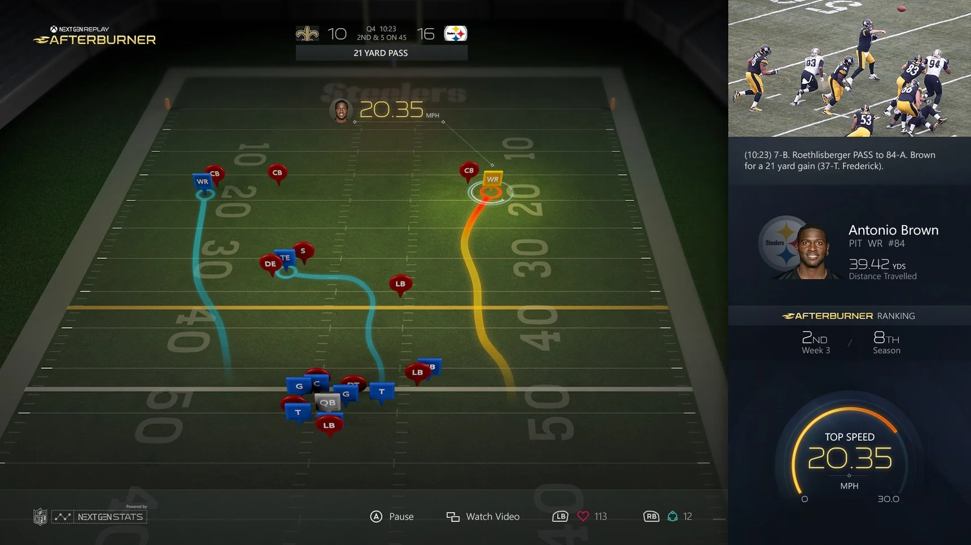
Overall Project Workflow
Understanding problem statement
Data Collection and Pre-Processing
Feature Engineering and Selection
Train Models / Hyperparameter Tuning
Evaluate Model Performance
Feature Importance and Model Interpretability
Tool for End User
Objective: Apply a model interpretability piece to our trained model in order to create a dashboard that is usable by football coaches and enthusiasts alike

Slide 2

Data
10 years (2009-2019) NFL play-by-play data
449,382+ plays
(255+ Features)
Weather Data
Madden
Win Probability Data

Slide 3

Models Evaluated
Classifier | Classifier Type
Logistic Regression | Regression
K-Nearest Neighbors | KNN
Decision Tree | Tree
Random Forest | Tree
Gradient Boosted Trees | Tree
Adaboost | Tree
XGBoost | Tree
LightGBM | Tree
CatBoost | Tree
Linear SVC | Support Vector Machine
SVC | Support Vector Machine
Feed Forward Neural Network (MLP) | Neural Network

Slide 4
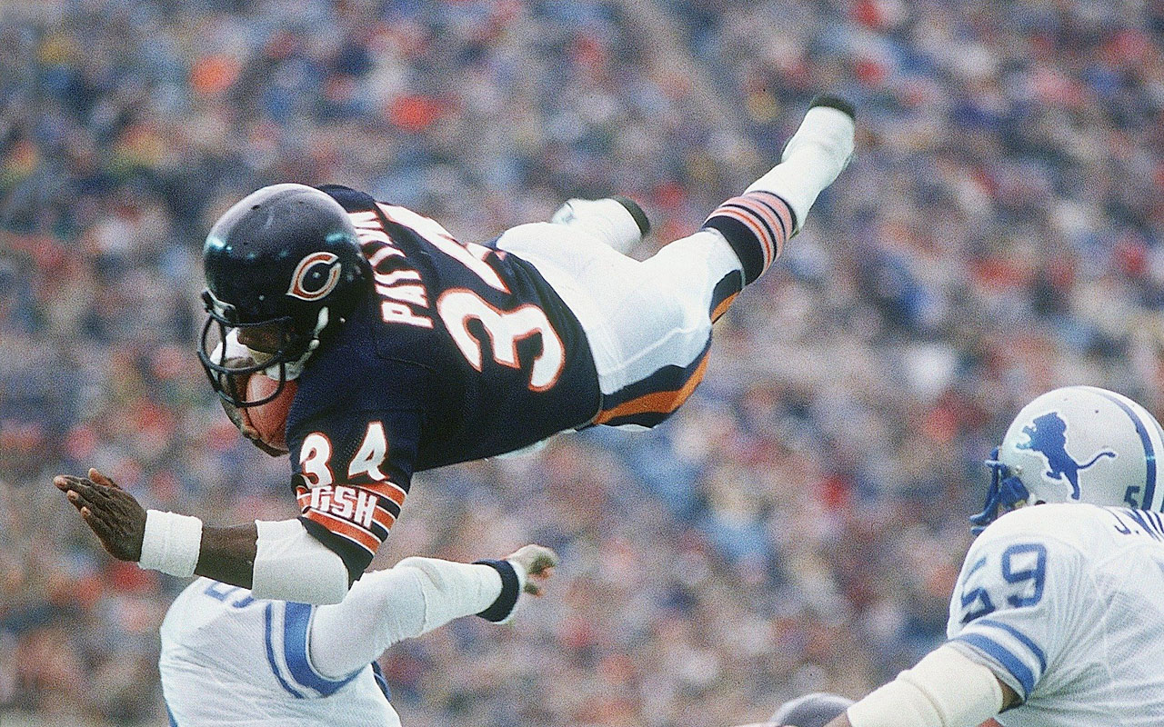
Hyper-Parameter Tuning Results
Classifier | Classifier Type | Library | Hyper-Parameter Tuning Method | # Iterations (excluding 5-fold CV) | 10-Fold CV Accuracy (Base) | 10-Fold CV Accuracy (Tuned) | Average Performance Difference
Logistic Regression | Regression | Scikit-Learn | Bayesian Search | 300 | 0.6664 (+/- 0.0117) | 0.6513 (+/- 0.0142) | -0.0151
K-Nearest Neighbors | KNN | Scikit-Learn | Exhaustive Search | 80 | 0.6144 (+/- 0.0118) | 0.6371 (+/- 0.0154) | 0.0227
Decision Tree | Tree | Scikit-Learn | Exhaustive Search | 33,264 | 0.6061 (+/- 0.0163) | 0.6709 (+/- 0.0144) | 0.0648
Random Forest | Tree | Scikit-Learn | Random Search | 1,000 | 0.6867 (+/- 0.0110) | 0.6911 (+/- 0.0163) | 0.0044
Gradient Boosted Trees | Tree | Scikit-Learn | Bayesian Search | 500 | 0.6676 (+/- 0.0129) | 0.6735 (+/- 0.0160) | 0.0059
Adaboost | Tree | Scikit-Learn | Exhaustive Search | 240 | 0.6871 (+/- 0.0114) | 0.6630 (+/- 0.0071) | -0.0241
XGBoost | Tree | XGBoost | Stepwise Exhaustive Search | 1,000 | 0.6866 (+/- 0.0101) | 0.6976 (+/- 0.0114) | 0.011
LightGBM | Tree | LightGBM | Bayesian Search | 10,000 | 0.6950 (+/- 0.0098) | 0.6782 (+/- 0.0174) | -0.0168
CatBoost | Tree | CatBoost | Bayesian Search | 100 | 0.6960 (+/- 0.0124) | 0.6958 (+/- 0.0155) | -0.0002
Linear SVC | Support Vector Machine | Scikit-Learn | Bayesian Search | 100 | 0.6668 (+/- 0.0111) | 0.6511 (+/- 0.0139) | -0.0157
SVC | Support Vector Machine | Scikit-Learn | Bayesian Search | 300 | 0.5531 (+/- 0.0444) | 0.5007 (+/- 0.0517) | -0.0524
Feed Forward Neural Network (MLP) | Neural Network | Keras (Tensorflow) | Stepwise Exhaustive Search | - | - | 0.5977 | -

Slide 5

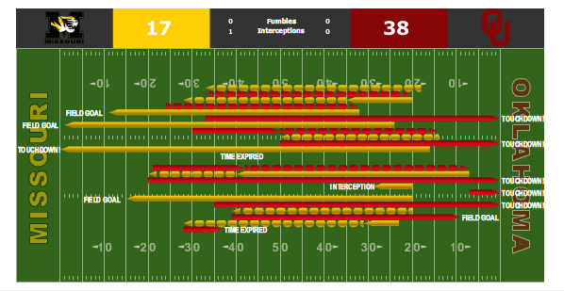
Model Evaluation (10-Fold CV)
Classifier | Accuracy | Balanced Accuracy | Precision | Average Precision | Recall | F1 | AUC
Logistic Regression | 0.6513 (+/- 0.0142) | 0.6535 (+/- 0.0161) | 0.5561 (+/- 0.0143) | 0.5894 (+/- 0.0274) | 0.6649 (+/- 0.0312) | 0.6056 (+/- 0.0198) | 0.7031 (+/- 0.0228)
K-Nearest Neighbors | 0.6371 (+/- 0.0154) | 0.6038 (+/- 0.0156) | 0.5645 (+/- 0.0256) | 0.5364 (+/- 0.0205) | 0.4329 (+/- 0.0209) | 0.4899 (+/- 0.0212) | 0.6621 (+/- 0.0155)
Decision Tree | 0.6709 (+/- 0.0144) | 0.6506 (+/- 0.0153) | 0.6006 (+/- 0.0231) | 0.6060 (+/- 0.0274) | 0.5463 (+/- 0.0382) | 0.5719 (+/- 0.0229) | 0.7194 (+/- 0.0205)
Random Forest | 0.6911 (+/- 0.0163) | 0.6688 (+/- 0.0166) | 0.6331 (+/- 0.0248) | 0.6502 (+/- 0.0255) | 0.5542 (+/- 0.0243) | 0.5909 (+/- 0.0216) | 0.7490 (+/- 0.0195)
Gradient Boosted Trees | 0.6735 (+/- 0.0160) | 0.6443 (+/- 0.0163) | 0.6184 (+/- 0.0266) | 0.6144 (+/- 0.0244) | 0.4942 (+/- 0.0227) | 0.5493 (+/- 0.0219) | 0.7213 (+/- 0.0215)
Adaboost | 0.6630 (+/- 0.0071) | 0.6430 (+/- 0.0081) | 0.5891 (+/- 0.0107) | 0.6082 (+/- 0.0158) | 0.5399 (+/- 0.0241) | 0.5633 (+/- 0.0134) | 0.7086 (+/- 0.0111)
XGBoost | 0.6976 (+/- 0.0114) | 0.6786 (+/- 0.0117) | 0.6367 (+/- 0.0173) | 0.6605 (+/- 0.0238) | 0.5806 (+/- 0.0209) | 0.6073 (+/- 0.0154) | 0.7566 (+/- 0.0187)
LightGBM | 0.6782 (+/- 0.0174) | 0.6479 (+/- 0.0178) | 0.6284 (+/- 0.0299) | 0.6300 (+/- 0.0256) | 0.4922 (+/- 0.0264) | 0.5520 (+/- 0.0245) | 0.7299 (+/- 0.0215)
CatBoost | 0.6958 (+/- 0.0155) | 0.6755 (+/- 0.0159) | 0.6362 (+/- 0.0228) | 0.6594 (+/- 0.0264) | 0.5714 (+/- 0.0250) | 0.6020 (+/- 0.0206) | 0.7554 (+/- 0.0202)
Linear SVC | 0.6511 (+/- 0.0139) | 0.6537 (+/- 0.0157) | 0.5557 (+/- 0.0140) | 0.5893 (+/- 0.0277) | 0.6669 (+/- 0.0308) | 0.6062 (+/- 0.0193) | 0.7030 (+/- 0.0228)
SVC | 0.5007 (+/- 0.0517) | 0.5464 (+/- 0.0196) | 0.4349 (+/- 0.0237) | 0.5251 (+/- 0.0307) | 0.7814 (+/- 0.1791) | 0.5561 (+/- 0.0380) | 0.6064 (+/- 0.0302)
Feed Forward Neural Network (MLP) | 0.5977 | - | - | - | - | - | -

